Slide 1


Advancing Recovery Capital and Mechanisms of Change through Community Collaboration Recovery Alliance Symposium 2026 John F. Kelly, PhD, ABPP
Notes:
Title: Recovery From Alcohol and Drugs Problems in a National Sample of U.S. Adults: Prevalence, Pathways, and Predictors
Talk Description: While much is known about the causes, clinical course, and treatment, of addiction, little is known about the prevalence, processes, pathways, and predictors of long-term remission and recovery.
This presentation reviews and discusses findings from the first nationally-representative study of U.S. adults who have resolved a significant alcohol or other drug problem, examines their varied pathways
to problem resolution, and describes the predictors of use of those pathways. Findings regarding changes in quality of life with time in recovery and smoking status and cessation will also be reviewed.
Learning Objectives
By the end of this presentation participants will be able to:
1. Describe recovery prevalence in the United States
2. Name the major pathways that people use to recover
3. Specify the changes in quality of life that occur with time in recovery

Slide 2
Disclosures
None

Slide 3

50 years
of criminal justice, treatment, and public health, approaches

Slide 4
Past 50 yrs since declaration of “War on drugs” led to large-scale federal appropriations and a number of paradigm shifts…
Etiology
Neurobiology
Epidemiology
Pathways
Clinical Course
Treatment
Notes:
Etiology: genetics/genomics/pharmacogenetics; and, greater recognition that AUD is a complex, multifactorially determined disorder involving genes/biology and environmental factors including early alcohol exposure….
Neurobiology: impacts on brain function and structure
Epidemiology: greater knowledge of prevalence, trends, comorbidity at-risk populations
Pathways: multiple pathways to recovery
Clinical Course: stages of change; heterogeneous presentation, impact, time to remission
Treatment: Behavioral and Pharmacological and increased recognition of continuing care and long-term recovery management….

Slide 5

Paradigm Shifts

Slide 8
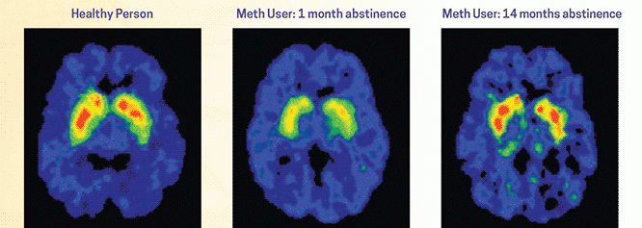
Changes in the brain with abstinence

Slide 9
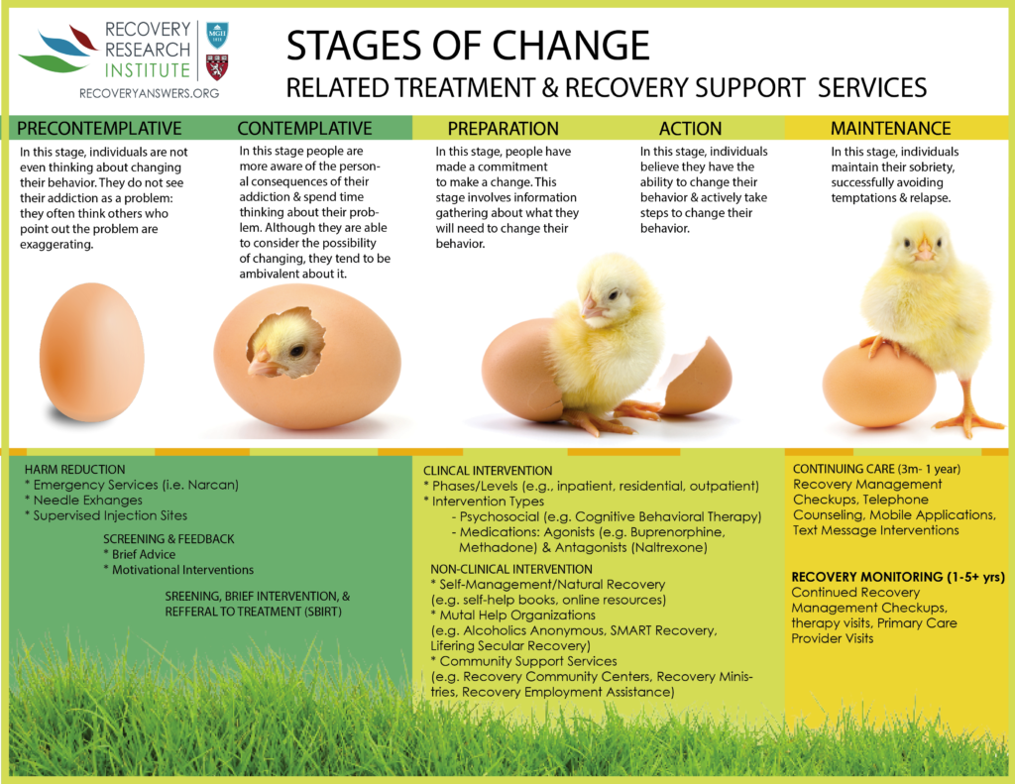
Notes:
An important conceptual model was the SOC model …. But SOC ends with “maintenance” and there is little explication as to what that entails … Also, the process from first help-seeking to full remission (1 yr without symptoms) can take many years and several interventions. What can be done to accelerate this process both in terms of full remission and stable recovery (i.e., 5 yrs without symptoms)?

Slide 10
Harm Reduction Strategies
Anti-craving/anti-relapse medications (“MAT”)
Overdose reversal medications (Narcan)
Needle exchange programs
Heroin prescribing
Overdose prevention facilities (safe Injection facilities)

Slide 11



What people really need is a good listening to…

Slide 12
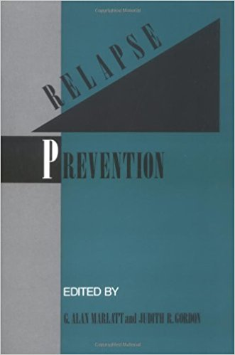
“Quitting is easy, I’ve done it dozens of times” –Mark Twain

Slide 13

Swift, certain, modest, consequences shape behavioral choices…

Slide 14
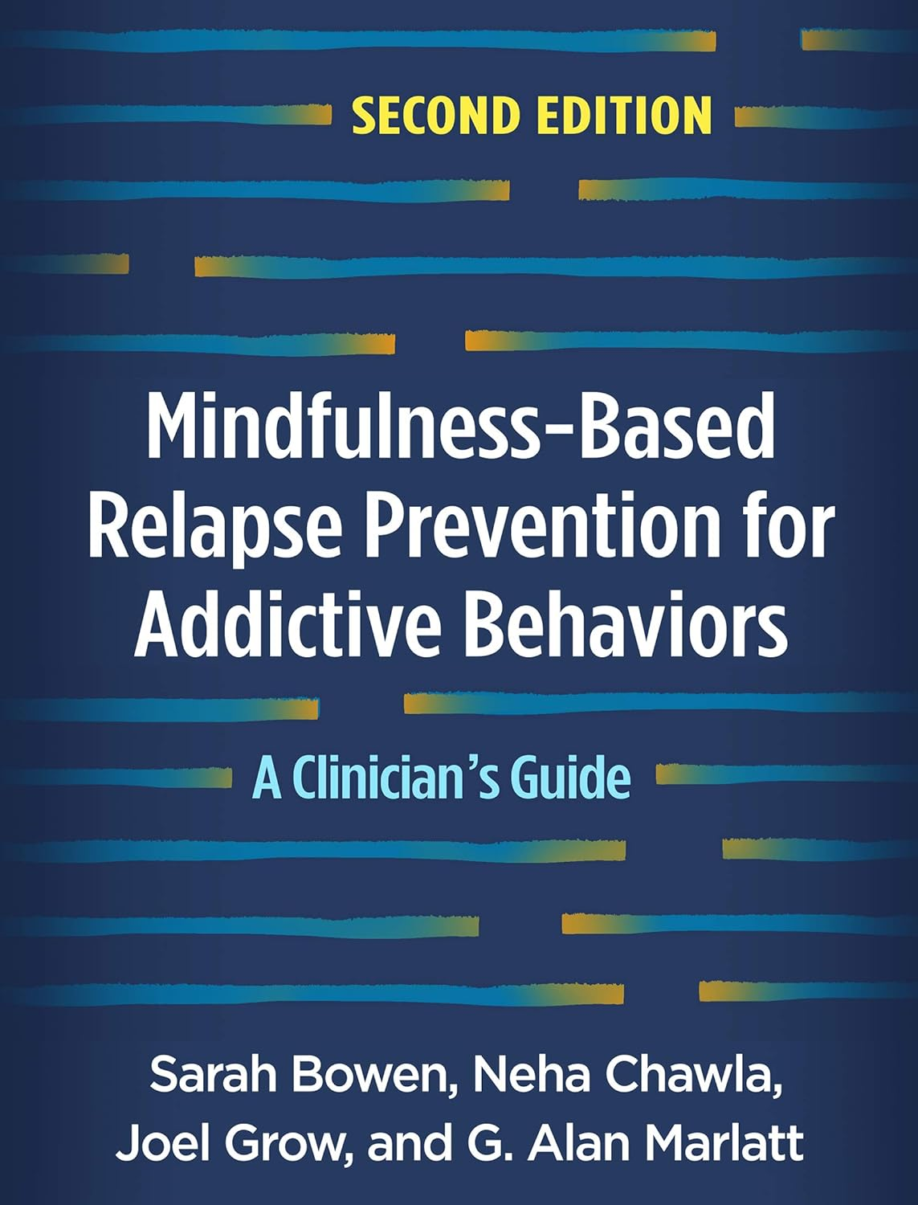
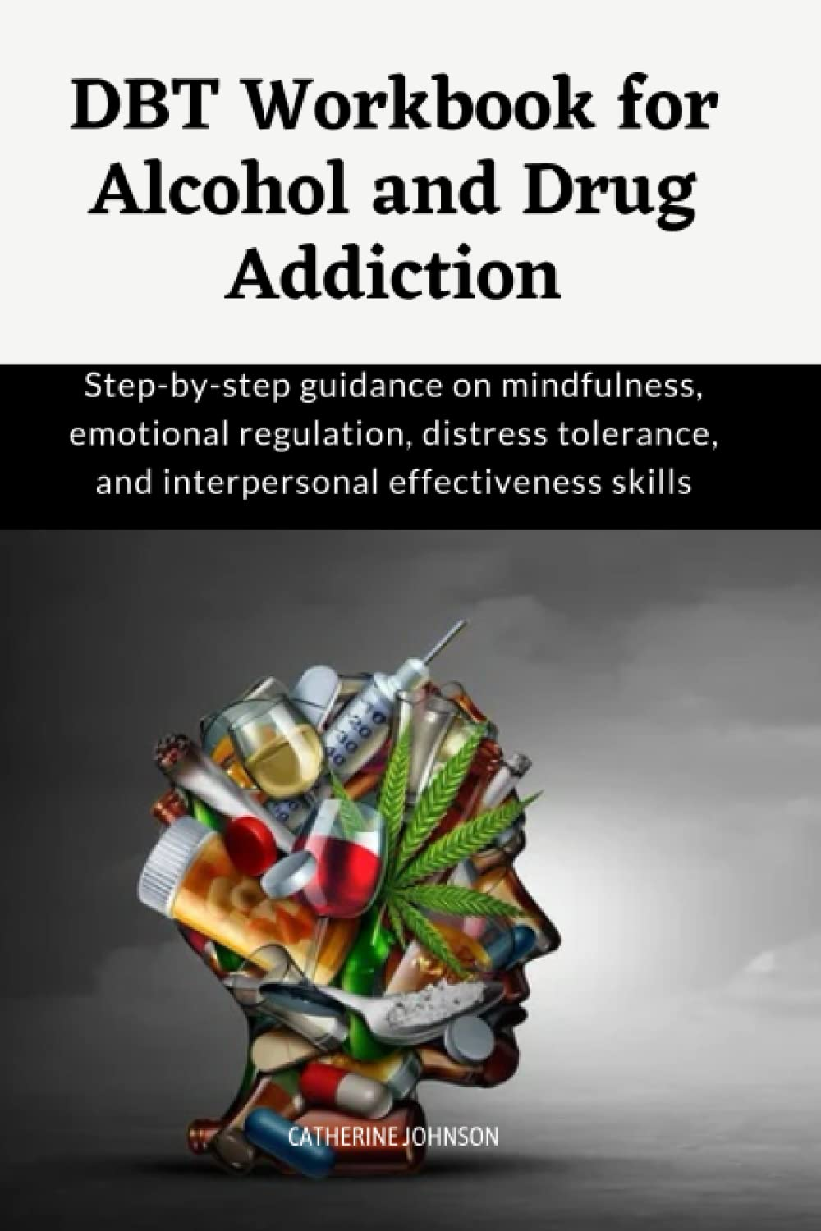

“Third wave” Psychotherapy approaches…

Slide 15

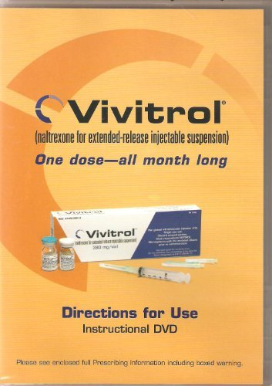
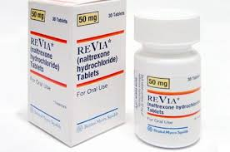
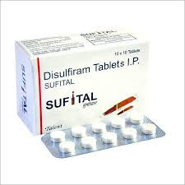
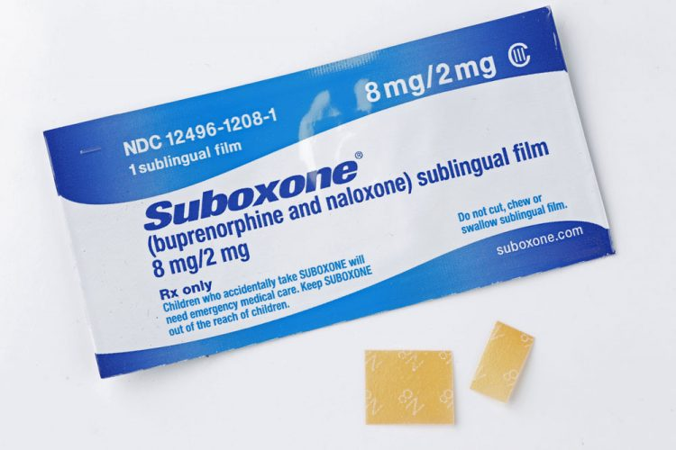
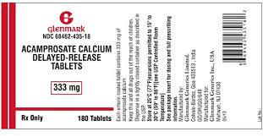

Slide 16

Digital Health

Slide 17
Overall SUD Severity (~48M in U.S. Population)
Severe
(~21%) ≈ 10M
(High morbidity / mortality)
Moderate
(~23%) ≈ 10–11M (Missing Middle)
Mild (~56%) ≈ 26–27M
Source: NSDUH, 2023

Slide 18

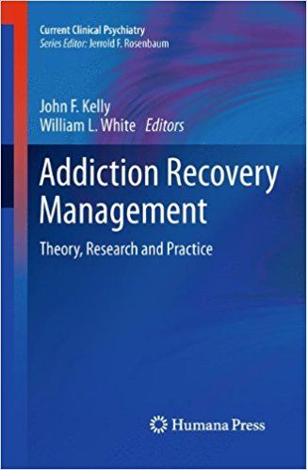
Also, there has been greater recognition that addiction (severe SUD) confers long-term vulnerability to disorder recurrence and reinstatement but also that there are millions of people living in long-term recovery from whom a great deal could be learned about their various successful pathways …

Slide 19
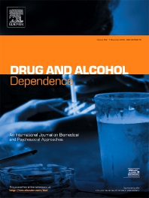

Slide 20
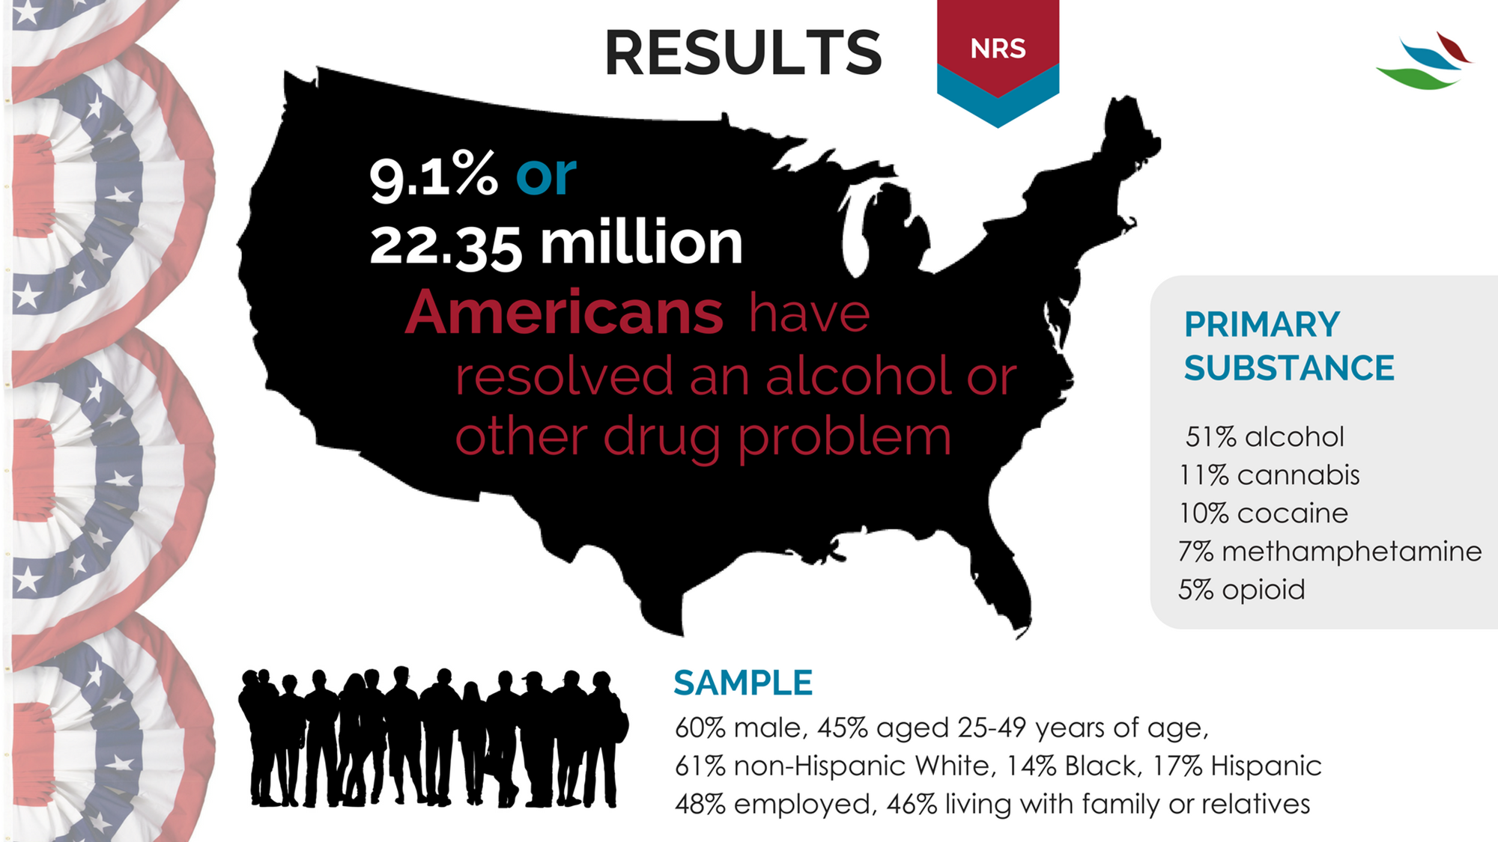

Slide 22




Multiple Pathways to Recovery
Acknowledges myriad ways in which individuals can recover:
Clinical pathways (provided by a clinician or other medical professional – both medication and psychosocial interventions)
Nonclinical pathways (services not involving clinicians such as Alcoholics Anonymous)
Self-management pathways (recovery change processes that involve no formal services, sometimes referred to as “natural recovery”)

Slide 24
Notes:
Alcoholics Anonymous (AA) 34.6 1.49 Narcotics Anonymous (NA) 17.5 1.23 Cocaine Anonymous (CA) 2.3 0.43 Celebrate Recovery 2.2 0.44 SMART Recovery 1.3 0.35 Women for Sobriety 1.2 0.37 Crystal Methamphetamine Anonymous (CMA) 0.8 0.37 Marijuana Anonymous (MA) 0.9 0.43 LifeRing Secular Recovery 0.4 0.27 Moderation Management 0.2 0.10 Secular Organizations for Sobriety (S.O.S.) 0.2 0.10 Other 3.2 0.47
Recovery support services 21.8 1.40 Faith-based recovery services 9.2 0.94 Sober living environment 8.5 0.95 Recovery community centers 6.2 0.85 State or local recovery community organization 3.0 0.61 College recovery programs/communities 1.7 0.52 Recovery high schools 0.8 0.37

Slide 25
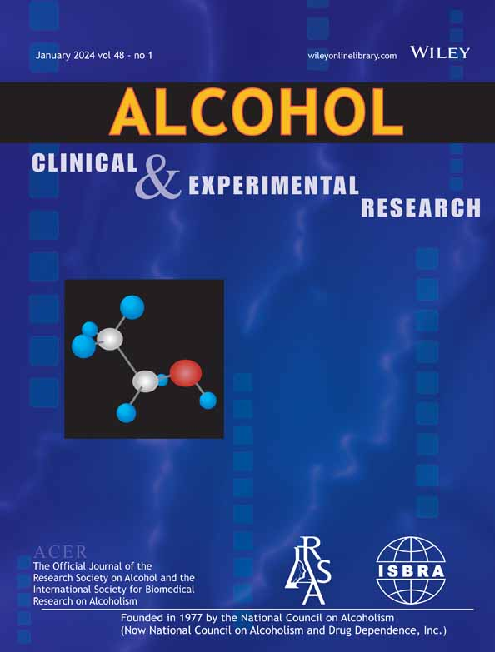

Slide 26
Frequency distribution of serious recovery attempts prior to successful resolution
(left: full sample; right: outliers removed)

Slide 27
Frequency distribution of serious recovery attempts prior to successful resolution
(left, full sample; right: outliers removed)
Skewness = 5.89, SE = 0.57; Kurtosis = 50.27, SE =9.66
SE: Standard Error

Slide 28
Frequency distribution of serious recovery attempts prior to successful resolution
(left, full sample; right: outliers removed)
 | Mean | Median
Full sample | 5.35 (13.41) | 2 (1, 4)

Slide 29
Median Recovery Attempts by Primary Drug
Notes:
Primary substance
Alcohol
5.38 (13.45)
2 (1, 4)
Cannabis
4.62 (8.41)
2 (1, 4)
0, 100
0.29
0.771
Opioids
8.48 (21.08)
3 (1, 6)
0, 100
0.90
0.368
Stimulants
4.64 (8.03)
2 (1, 5)
0, 100
0.35
0.725
Other Drugs
3.00 (4.01)
1 (1, 6)
0, 20
-0.86
0.392
Depressive Disorder

Slide 30
Number of recovery attempts by clinical and recovery support services use

Slide 31
The clinical course of addiction and achievement of stable recovery can take a long time …
Can we speed this up?
Addiction Onset
Help Seeking
Full Sustained Remission
Risk drops below 15%
4-5 years
8 years
5 years
Opportunity for earlier detection through screening in non-specialty settings like primary care/ED
Self-initiated cessation attempts
4-5 Treatment episodes/
mutual-help
Continuing care/
mutual-help
60-75% of individuals with SUD will achieve full sustained remission
Recovery Priming
Recovery Mentoring
Recovery Monitoring
Kelly JF (2022) Psychiatr Clin North Am
.
Notes:
Wang, P. S., Berglund, P., Olfson, M., Pincus, H. A., Wells, K. B., & Kessler, R. C. (2005). Failure and delay in initial treatment contact after first onset of mental disorders in the National Comorbidity Survey Replication. Arch Gen Psychiatry, 62(6), 603-613. doi: 62/6/603 [pii]
10.1001/archpsyc.62.6.603
NSDUH (SAMHSA, 2021) shows annual prevalence of AUD or other SUD is approximately 15%
60-75% FSR from AUD/SUD see Jones et al, 2020; Kelly et al, 2017; White, 2012
Dennis, M. L., Scott, C. K., Funk, R., & Foss, M. A. (2005). The duration and correlates of addiction and treatment careers. J Subst Abuse Treat, 28 Suppl 1, S51-62. doi: S0740-5472(04)00138-2 [pii] 10.1016/j.jsat.2004.10.013
De Soto, C.B., O’Donnell, W.E., & De Soto, J.L. (1989). Long-term recovery in alcoholics. Alcoholism: Clinical and Experimental Research, 13, 693-697.
Vaillant, G. E. (1996). A long-term follow-up of male alcohol abuse. Archives of General Psychiatry, 53(3), 243-249.
Nathan, P., & Skinstad, A. (1987). Outcomes of treatment for alcohol problems: Current methods, problems and results. Journal of Consulting and Clinical Psychology, 55, 332-340. Dawson, D. A. (1996). Correlates of past-year status among treated and untreated persons with former alcohol dependence: United States, 1992. Alcoholism: Clinical and Experimental Research, 20(4), 771-779.
Jin, H., Rourke, S. B., Patterson, T. L., Taylor, M. J., & Grant, I. (1998). Predictors of relapse in long-term abstinent alcoholics. Journal of Studies on Alcohol, 59, 640-646. Dennis, M. L., Foss, M. A., &
Scott, C. K. (2007). An eight-year perspective on the relationship between the duration of abstinence and other
aspects of recovery. Evaluation Review, 31(6), 585-612.
Schutte, K., Byrne, F., Brennan, P., & Moos, R. (2001). Successful remission of late-life drinking problems: A 10-year follow-up. Journal of Studies on Alcohol 62, 322-334.

Slide 32
50 years of Progress: Burning building analogy…
Putting out the fire –addressing acute clinical pathology - good job
Preventing it from re-igniting (RP) - emphasized - pragmatic disconnect…
Building materials (recovery capital) – mostly neglected
Scaffolding (building skills and support beyond acute stabilization)
Granting “rebuilding permits” - (removing barriers - neglected)
Notes:
15 yrs is too long to accrue QOL comparable to gen. pop. This may be due historically to acute treatment paradigm and lack of emphasis on “architectural planning” provision of “building materials” (recovery capital) and granting of “Building permits” . These may increase sense of personal agency and control over their lives and environment (and thereby possibly facilitate neurochemical changes that can decrease risk of relapse).

Slide 33

Recovery Capital
Individual
(coping, motivation, self-efficacy)
Social
(recovery-specific/family, friends)
Financial
(income, resources)
Cultural
(identity, values)

Slide 34



How Organisms Recover
Photosynthesis
Psychosynthesis

Slide 35
A Social Activity Nutrition Emotion Regulation (SANER)
Approach to Recovery
Social
Social
Activity
Nutrition
Emotion
Regulation
(SANER)
Recovery
(Psychosynthesis)
Activity
Emotion Regulation
Nutrition
Kelly JF (2021; 2022)

Slide 36
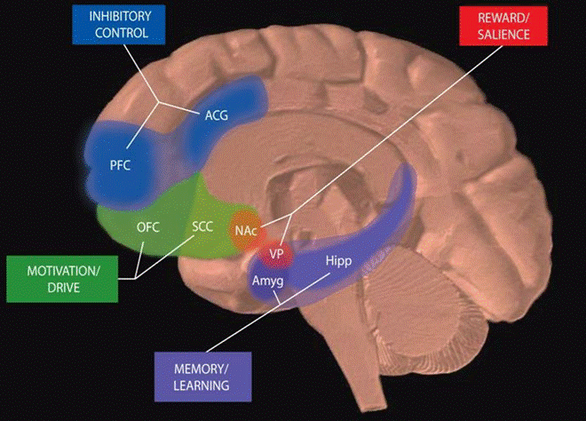
Neuroscience of Recovery Capital
Can social factors, recovery housing, and employment, change the brain, mitigate stress, upregulate down-regulated receptor systems, and increase the chances of long-term remission?
Notes:
What about the bio/neurobiological?

Slide 37
Social factors are key in the onset and offset of SUD
People want to use substances for 4 main reasons:
To feel good
To feel better
To do better
Because others are doing it
Kelly JF (2018)

Slide 38
Social factors are key in the onset and offset of SUD
People want to use substances for 4 main reasons: | People want to stop using substances and recover for the same 4 main reasons:
To feel good | To feel good
To feel better | To feel better
To do better | To do better
Because others are doing it | Because others are not doing it
Kelly JF (2018)

Slide 39







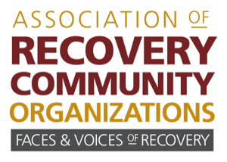


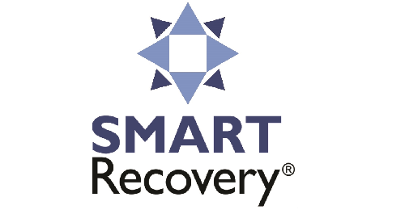
Recovery support services have grown intended to facilitate access to conducive and supportive environments and recovery capital …
Recovery
Mutual help organizations
Peer-based recovery support services
Recovery Residences
Clinical models of long-term recovery management
Recovery community centers
Recovery supports in educational settings
Notes:
Shout out to NIDA for R24

Slide 40
Advantages of recovery support services in disease/recovery management….
Available
Accessible
Flexible
Low/no cost
Enduring

Slide 41
Recovery support services have grown intended to facilitate access to conducive and supportive environments and recovery capital …
Recovery
Mutual help organizations
Peer-based recovery support services
Recovery Residences
Clinical models of long-term recovery management
Recovery community centers
Recovery supports in educational settings
Notes:
Shout out to NIDA for R24

Slide 42
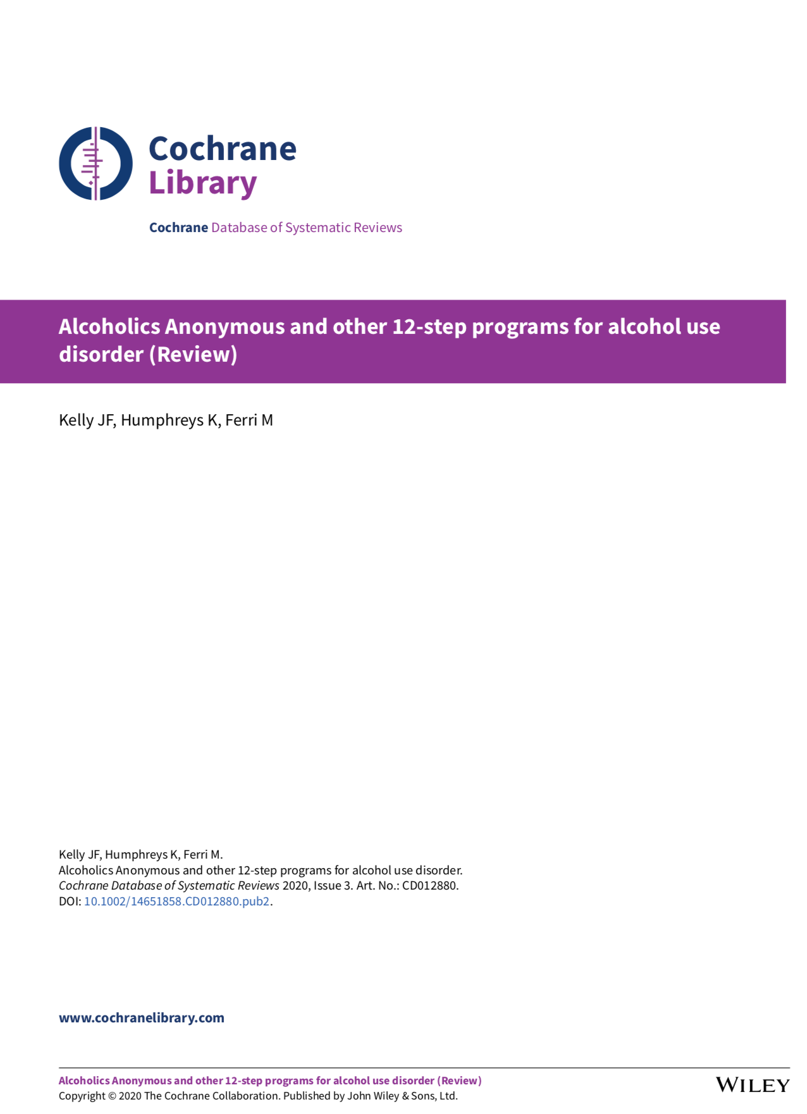
Cochrane Systematic Review on AA/TSF (2020)
Kelly, JF
Humphreys, K
Ferri, M
Notes:
117 pages + title page and table of contents (3 pages)

Slide 43
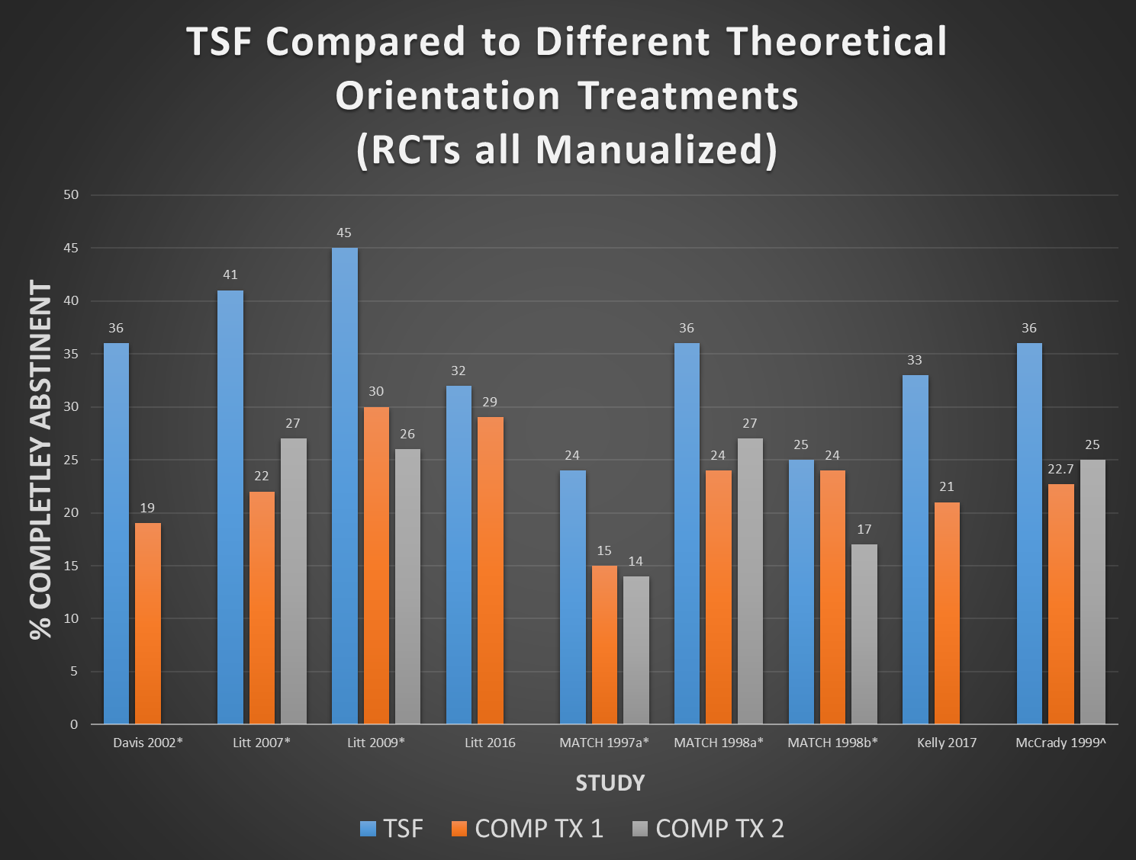
Kelly et al, 2020; Alcohol and Alcoholism

Slide 44
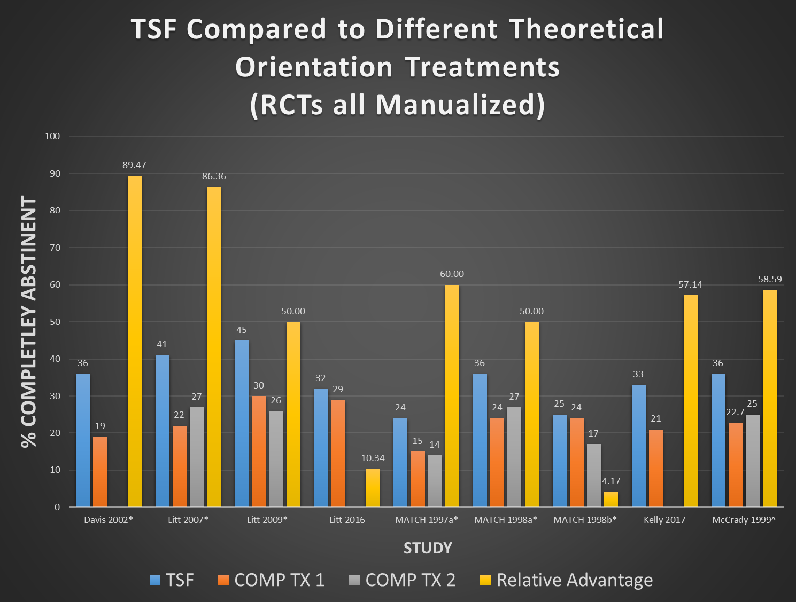
Kelly et al, 2020; Alcohol and Alcoholism

Slide 45

Economic Studies
Healthcare Cost Savings
3/4 included studies in this category (n reports = 4/5; found sig. health care cost saving in favor of the AA/TSF condition.
Economic analyses found benefits in favor of AA/TSF relative to outpatient treatment, and CBT interventions.
Magnitude - large. In addition to sig. increased abstinence/remission, compared to CBT interventions delivered in residential VA, AA/TSF reduces mental health and substance use related healthcare costs over next 2 years by over $10,000 per patient (converted to 2018 U.S. dollars).
>1M people treated for AUD in U.S. annually -reducing their health care costs by this amount would produce large aggregate economic savings (e.g., >$10 billion in the U.S. alone) as well as improving clinical outcomes
While AA is proven to help, not everyone wants to use AA
Increasing the menu of recovery mutual-help support options is likely to engage more individuals in the recovery process
$10-15 Billion/yr savings
in health care alone
In short: AA may be the
closest thing public health has
to “a free lunch”
Kelly et al, 2020; Alcohol and Alcoholism

Slide 46

Do Fitness Centers Keep people fit?
Of course!
If you go and if you work out regularly
Ongoing challenge is engaging and retaining people in some kind of ongoing exercise regimen…
Fitness Centers therefore provide not just one, but an array, of different classes, spaces, equipment, pools, and courts, so that people can find something appealing…
…and move toward increasing physical fitness
Kelly et al, 2025; American Jnl Pub Hlth

Slide 47
Emerging Evidence for Additional Mutual-Help Organizations….

Slide 48
In studies that conducted and reported mediational analyses…AA/TSF Causal chain supported…
BETTER OUTCOME
TSF
AA

Slide 49
What about support for causal chain of purported mechanisms of AA on outcomes?
MOBC?
BETTER OUTCOME
TSF
AA

Slide 50
Empirically-supported MOBCs through which AA confers benefit
Social network
Spirituality
But which is most important?
And for whom?
And when?
Social Abstinence self-efficacy
Coping skills
Recovery motivation
Negative Affect Abstinence self-efficacy
Impulsivity
Craving
Notes:
So, if we apply these to models of common precursors to relapse…

Slide 51
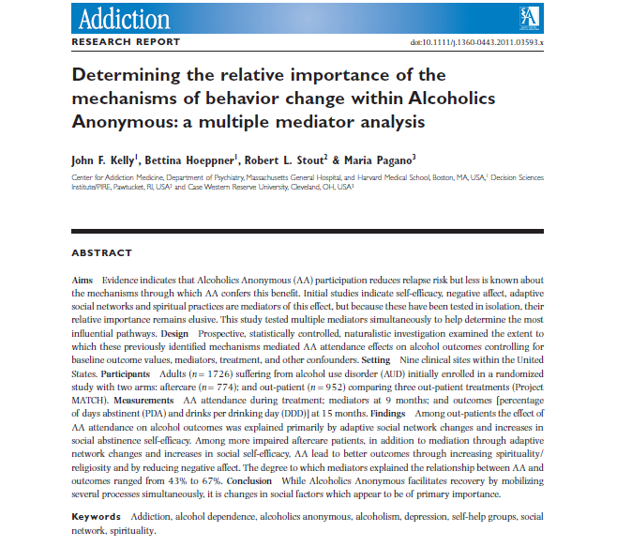
Based on prior mediators of AA on outcomes, several fully temporally lagged multiple mediator and moderated multiple mediator analyses have been conducted…

Slide 52
Source: Kelly, Hoeppner, Stout, Pagano (2012) , Determining the relative importance of the mechanisms of behavior change within Alcoholics Anonymous: A multiple mediator analysis. Addiction 107(2):289-99

Slide 53
Do more and less severely alcohol dependent individuals benefit from AA in the same or different ways?
effect of AA on alcohol use for AC was explained by social factors but also by S/R and through boosting NA ASE (DDD only)
Majority of effect of AA on alcohol use for OP was explained by social factors
Source: Kelly, Hoeppner, Stout, Pagano (2012) , Determining the relative importance of the mechanisms of behavior change within Alcoholics Anonymous:
A multiple mediator analysis. Addiction 107(2):289-99

Slide 54
Do men and women benefit from AA in the same ways?
NA ASE was a MOBC for women but not men - suggests that boosts in NA ASE were available in AA but men didn’t find this aspect relevant.
For men, AA was a way to help them find new sober friends and boost their social ASE much more than women
Source: Kelly and Hoeppner (2013) , Does Alcoholics Anonymous work differently for men and women? A moderated multiple-mediation analysis in a large clinical sample. Drug and Alcohol Dependence
Notes:
Men may use AA more than women to help them buffer socially-relevant relapse risks. Women appear to benefit in similar ways, but more work is needed to understand the additional ways women derive recovery benefit from AA. The pattern of findings underscores some gender-based differences that may have broader implications for the addiction treatment and recovery field. For women between the ages of 30 and 50, a focus on finding alternative ways to cope with negative affect may yield recovery benefits, while among men in the same life-stage, a relatively greater focus on coping with high risk social situations may yield recovery related benefits.

Slide 55
Moderated-Mechanisms: AA effects Moderated by Severity, Gender…
CONCLUSIONS
Of note, this MOBC research finds that the same entity/intervention (i.e., AA) produces benefits that differ in nature and magnitude between more severely alcohol involved/impaired and less severely alcohol involved/impaired; and men and women
Differences may reflect differing needs based on recovery challenges related to differing symptom profiles, degree of subjective suffering and perceived severity/threat, life-stage based recovery contexts, and gender-based social roles & drinking contexts

Slide 56
Similar to psychotherapy literature…
Rather than thinking about how AA or similar interventions “work”…
Better to think how individuals use or make these interventions work for them – to meet most salient needs at any given phase of recovery and considering life-stage and contexts (e.g., social roles/behavior)

Slide 57
Recovery support services have grown intended to facilitate access to conducive and supportive environments and recovery capital …
Recovery
Mutual help organizations
Peer-based recovery support services
Recovery Residences
Clinical models of long-term recovery management
Recovery community centers
Recovery supports in educational settings
Notes:
Shout out to NIDA for R24

Slide 58
Oxford House vs. Usual Care
Recovery Residences had –
half as many using substances across 2 yrs
50% more employed
1/3 re-incarceration rate
Jason et al (2008) Comm Hlth

Slide 59
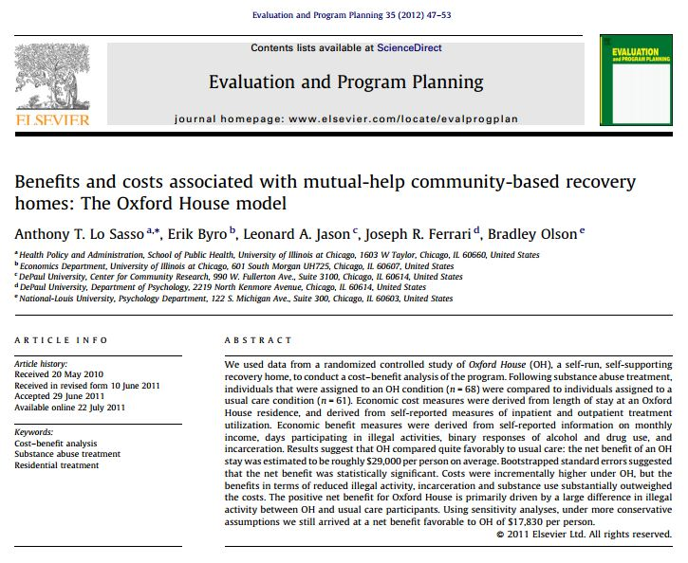
Cost-benefit analysis of the Oxford House Model
Sample: 129 adults leaving substance use treatment between 2002 and 2005
Design: Cost-benefit analysis using RCT data
Intervention: Oxford House vs. usual continuing care
Follow-up: 2 years
Outcome: Substance use, monthly income, incarceration rates
Notes:
Jason, Olson, Ferarri, Lo Sasso, 2006

Slide 60
Mean per-person societal benefits and costs
Notes:
Assumptions: inpatient and outpatient treatment sessions last one full
workday so that patients forfeit an entire day (8 hours) of work, and that patients attend 20 sessions per program

Slide 61
Recovery support services have grown intended to facilitate access to conducive and supportive environments and recovery capital …
Recovery
Mutual help organizations
Peer-based recovery support services
Recovery Residences
Clinical models of long-term recovery management
Recovery community centers
Recovery supports in educational settings
Notes:
Shout out to NIDA for R24

Slide 62
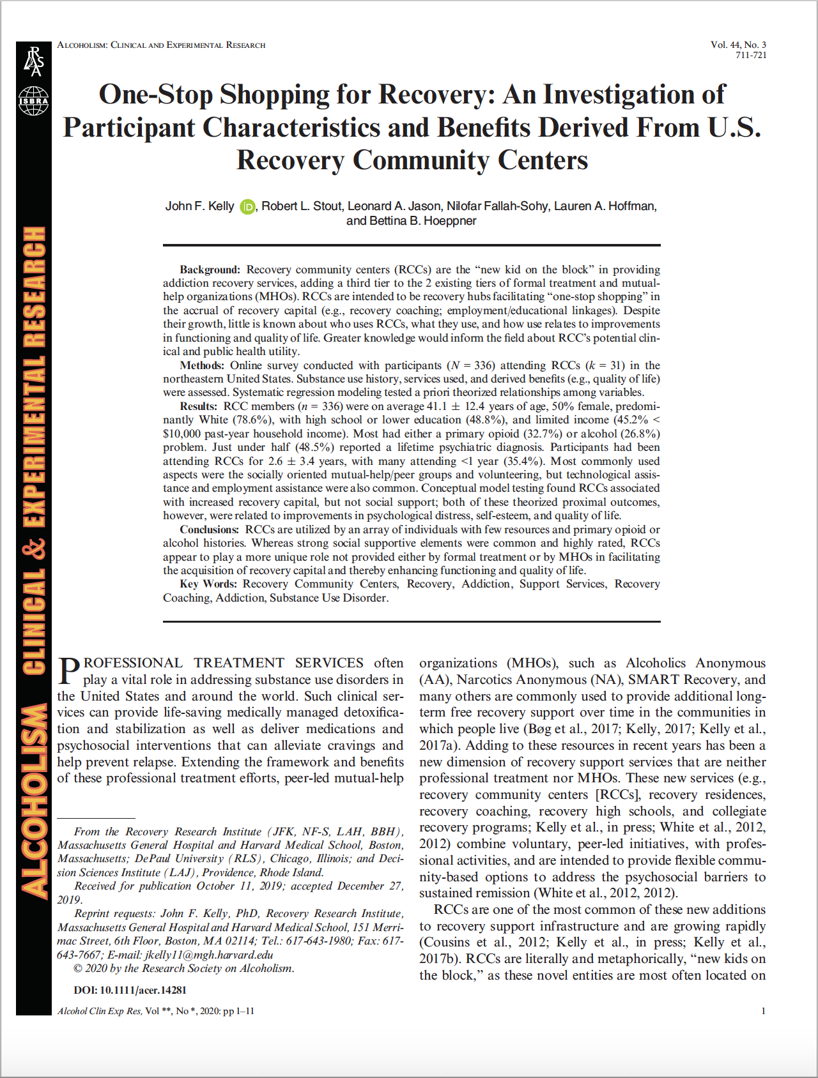
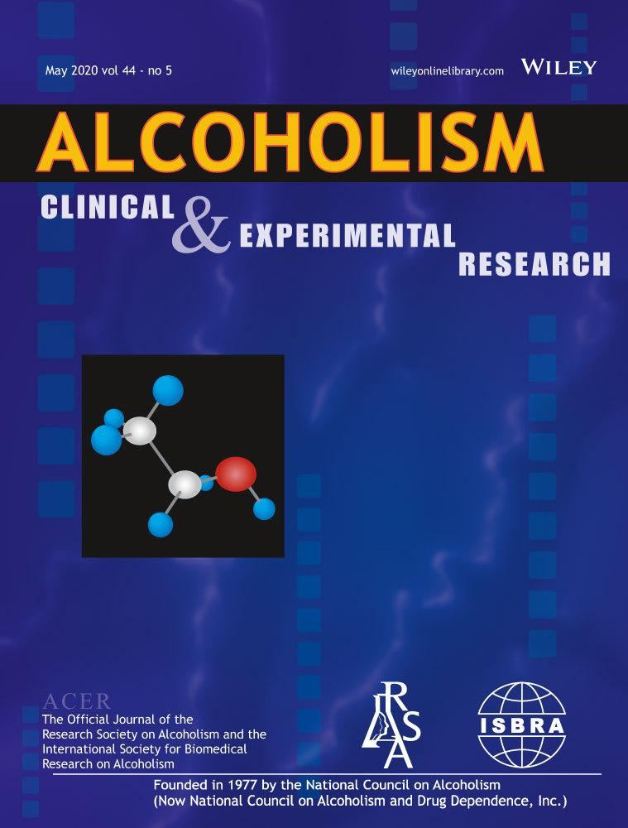

Slide 63
Services provided
Peer-Facilitated Support Groups
Mental Health Support
Mutual-Help Meetings
Technology/Internet
Education Assistance
Health Nutrition Exercise
Volunteering
Smoking Cessation
Childcare Services
Housing Assistance
Family Support Services
All recovery meetings
Financial Services
NARCAN Training
Medication-Assisted Treatment Support
Employment Assistance
Legal Assistance
Basic Needs Assistance
Recreational Activities
Expressive Arts
Recovery Coaching

Slide 64
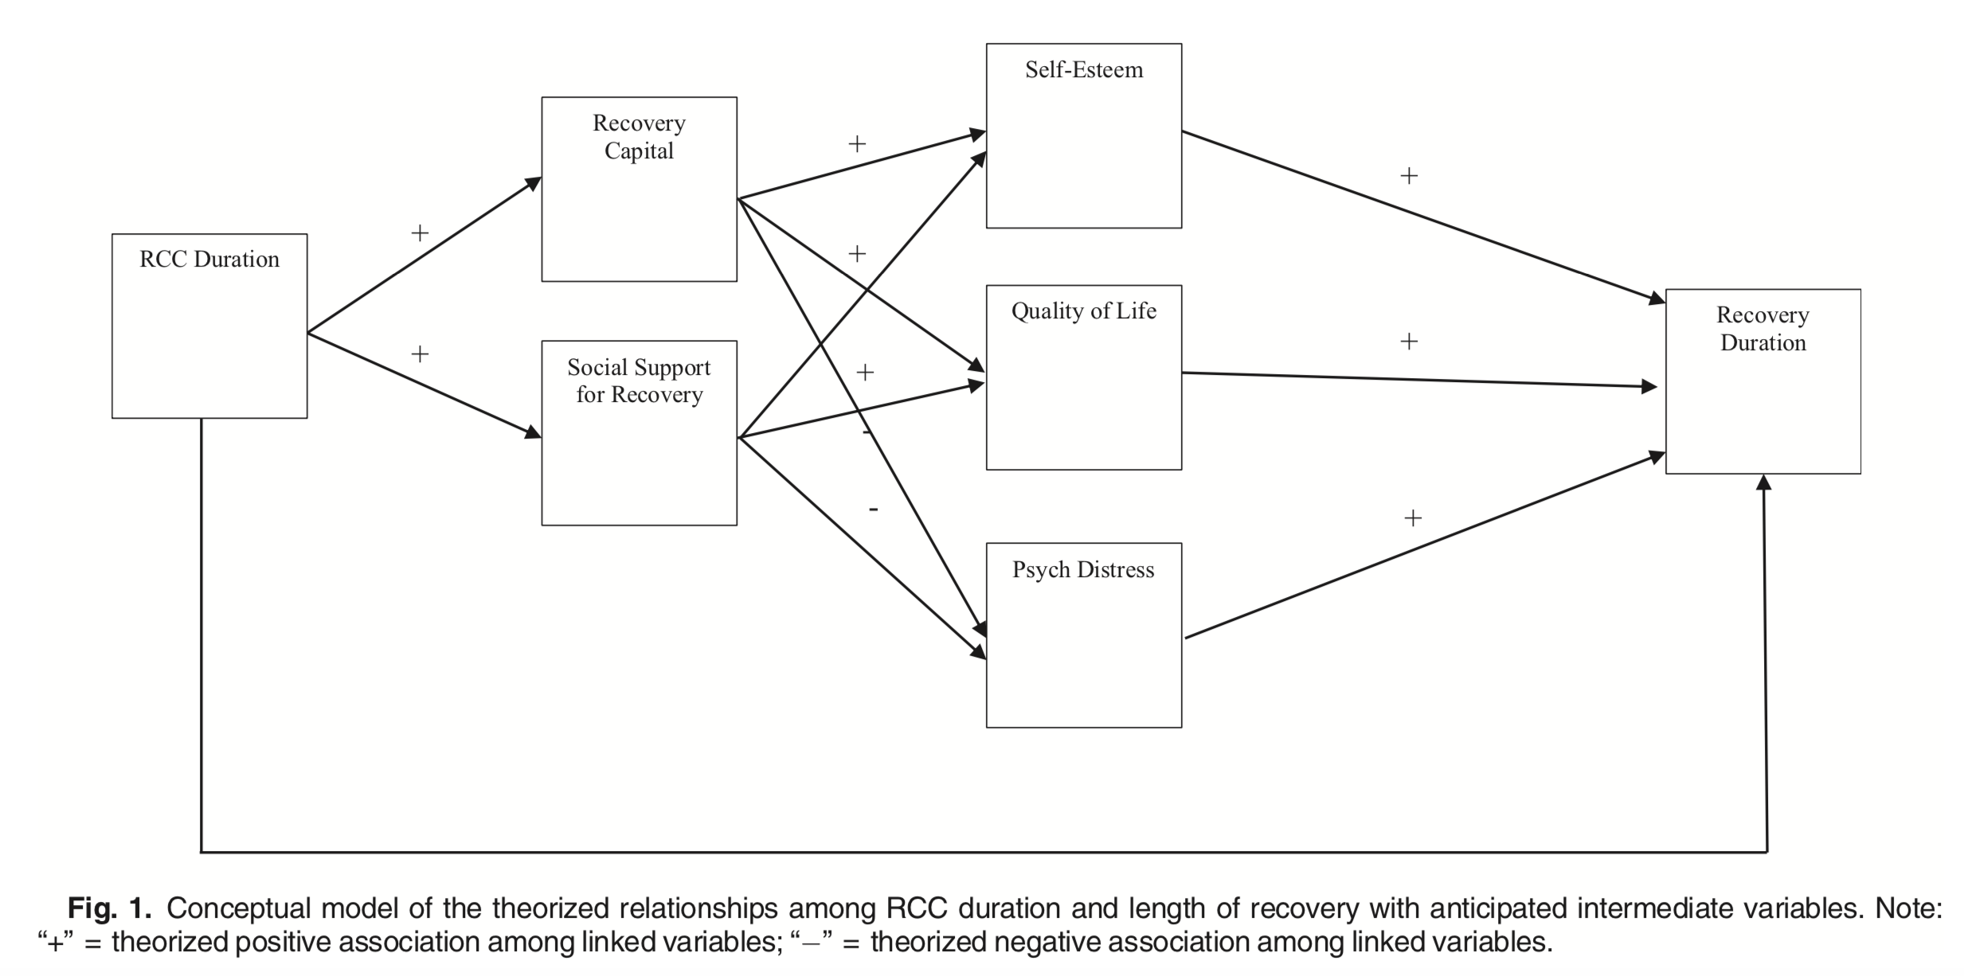
Whereas strong social supportive elements were common and highly rated, RCCs appear to play a more unique role not provided either by formal treatment or by MHOs in facilitating the acquisition of recovery capital and thereby enhancing functioning and quality of life.

Slide 65
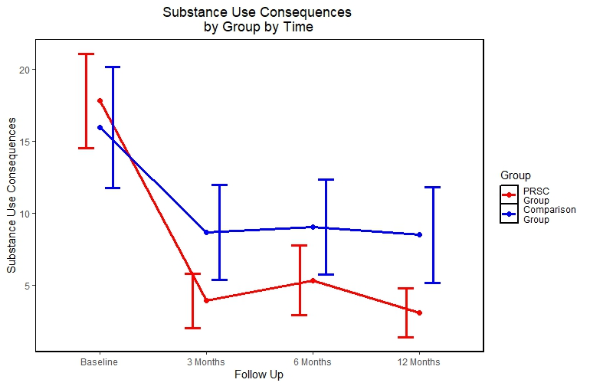
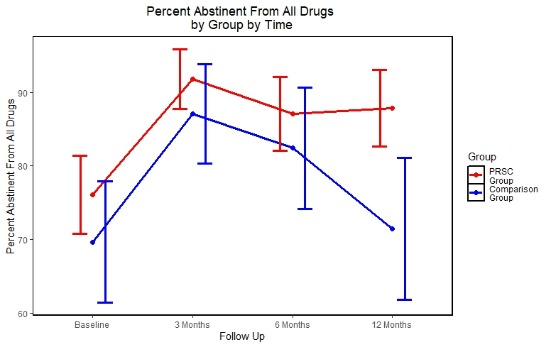
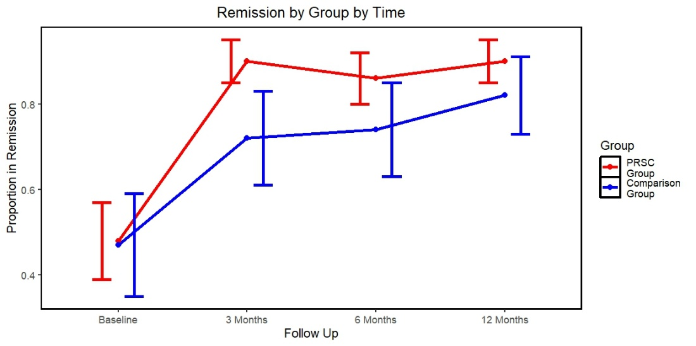
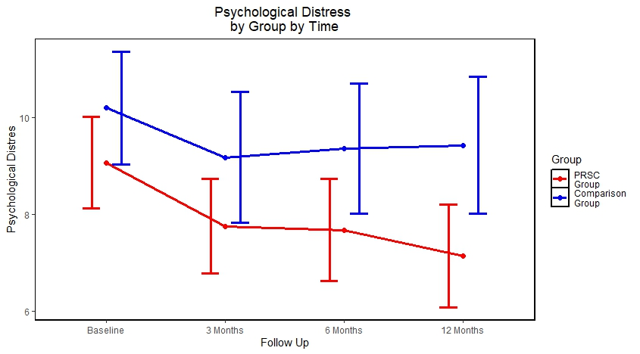
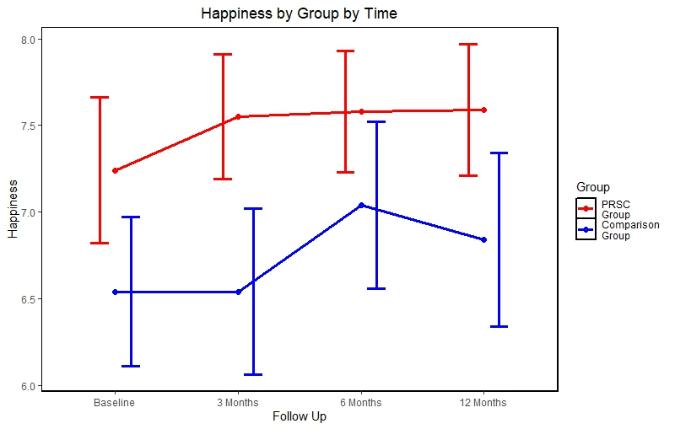
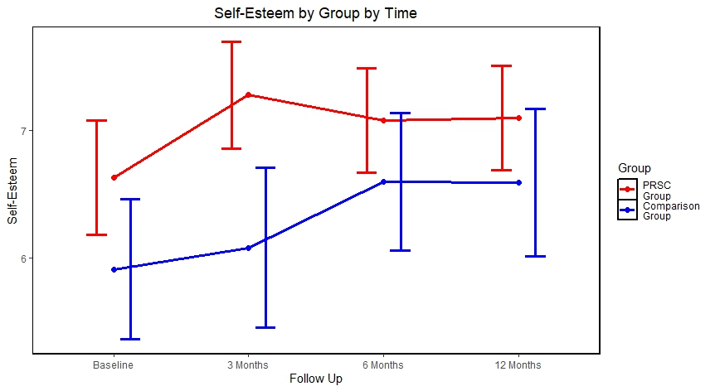
Higher Remission Rates
Fewer Substance-Related Consequences
Higher Abstinence Rates
Fewer Psychiatric Problems
Higher Self-Esteem and Pos. Soc. Identity
Higher Life Satisfaction

Slide 66
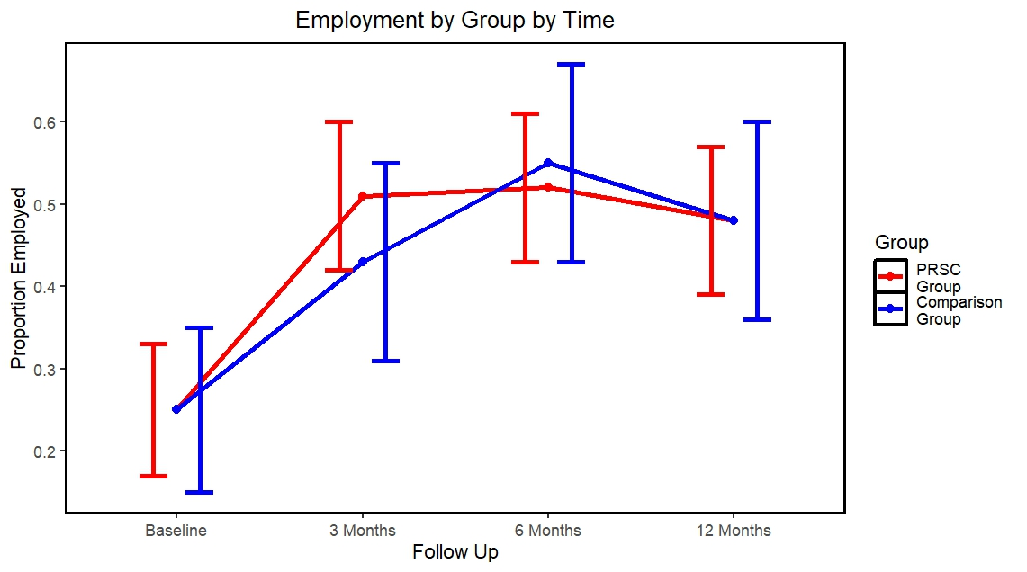
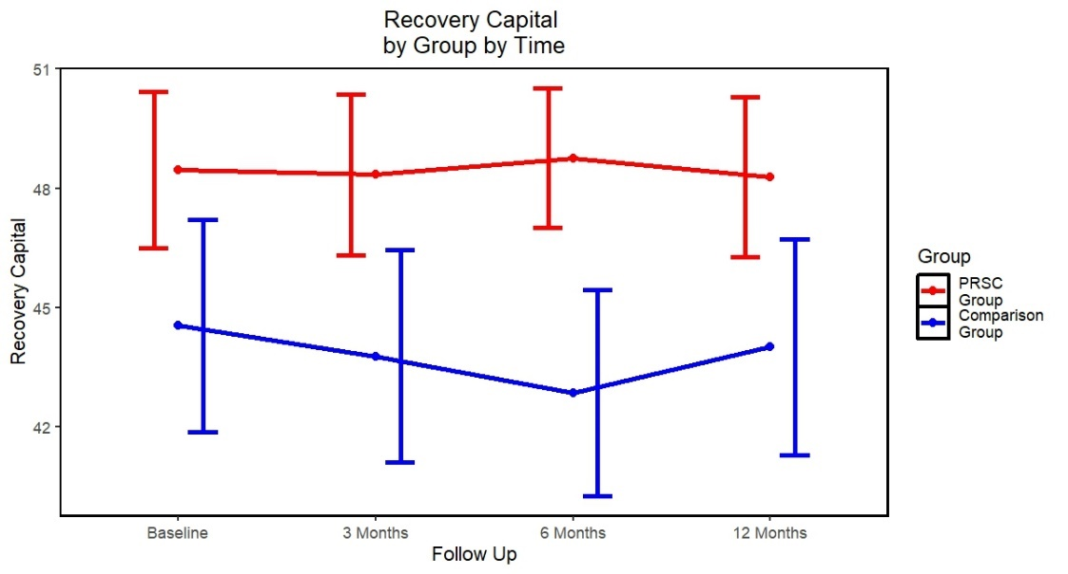
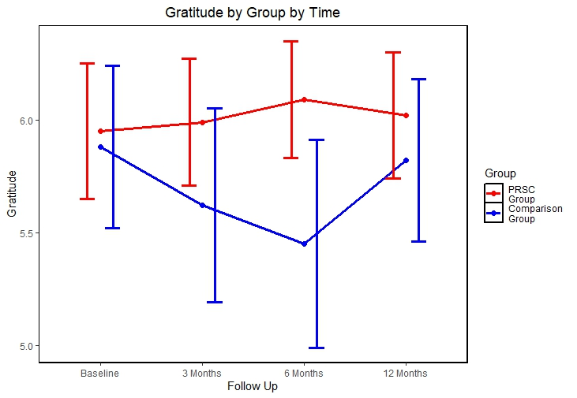
Double Employment Rates
Higher Recovery Capital Rates
Greater Gratitude

Slide 67
40-Year Time Frame of Recovery Trajectories
National
Recovery Study (NRS)
N=2,002
Takes 15 yrs for recovering pop to reach
Same level as general pop.
Data now suggest individuals utilizing Recovery Community Centers’
“one stop shop for recovery” may achieve that same level in just 5 yrs!
Kelly et al, 2018; Beyond Abstinence; Alcoholism: Clinical Experimental Research

Slide 68


How do people sustain change over the long-term? Relapse + recurrence vs resilience + recovery Long-Term Relapse - Markers, Mechanisms, and Implications for Disease Management

Slide 69



Slide 70
Results: Research Questions
1. What are the commonly reported bio-psycho-social and health service use changes that occur in the year prior to a relapse following full sustained remission for individuals recovering from AUD and to what degree of certainty do such individuals attribute such changes as contributing to their relapse.
2. What is the nature and prevalence of the reported contributing relapse factors
3. When do such potential high-risk warning signs occur during the year prior to a long-term relapse.
4. What is the single most influential reported contributor of relapse among individuals in prior full sustained remission who have subsequently relapsed.

Slide 71
Results: Research Questions
1. What are the commonly reported bio-psycho-social and health service use changes that occur in the year prior to a relapse following full sustained remission for individuals recovering from AUD and to what degree of certainty do such individuals attribute such changes as contributing to their relapse.
2. What is the nature and prevalence of the reported contributing relapse factors
3. When do such potential high-risk warning signs occur during the year prior to a long-term relapse.
4. What is the single most influential reported contributor of relapse among individuals in prior full sustained remission who have subsequently relapsed.

Slide 72
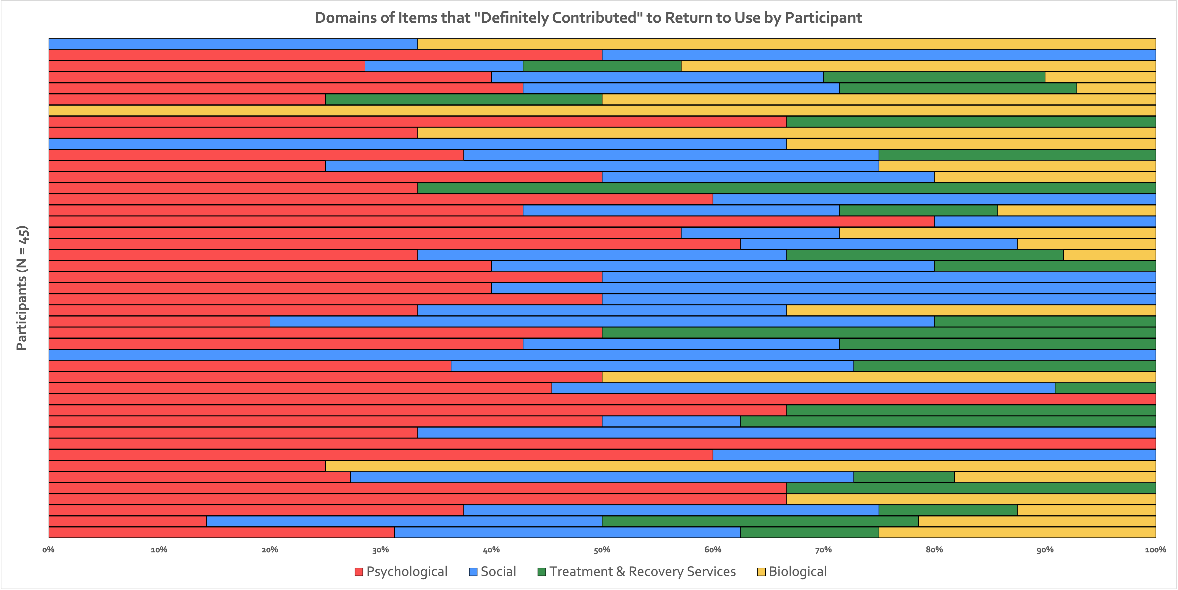
Change factors ranked by frequency
of occurrence

Slide 73
Results: Research Questions
1. What are the commonly reported bio-psycho-social and health service use changes that occur in the year prior to a relapse following full sustained remission for individuals recovering from AUD and to what degree of certainty do such individuals attribute such changes as contributing to their relapse.
2. What is the nature and prevalence of the reported contributing relapse factors within people
3. When do such potential high-risk warning signs occur during the year prior to a long-term relapse.
4. What is the single most influential reported contributor of relapse among individuals in prior full sustained remission who have subsequently relapsed.

Slide 74
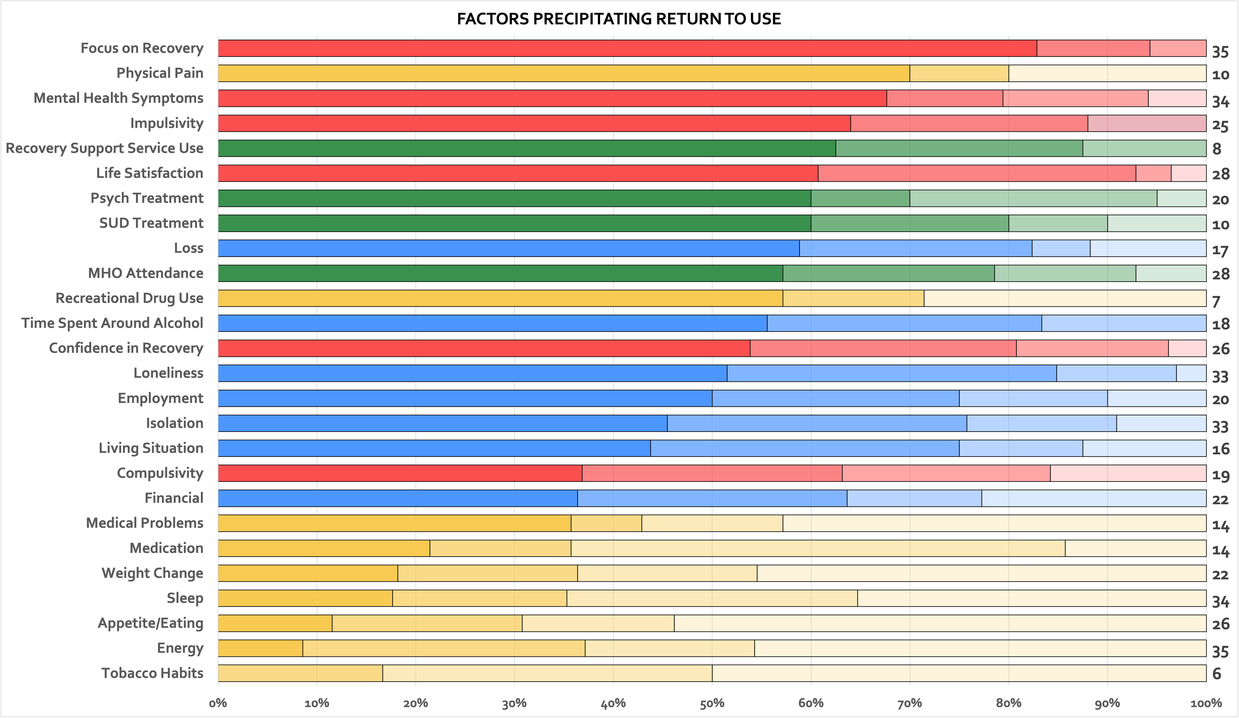
Change factors ranked by risk potency
(degree to which they “definitely”
contributed to relapse)

Slide 75


Recovery is like riding a bike: to stay balanced you have to keep pedaling…
You can coast for a while, but if you don’t peddle sooner or later you’ll start to wobble and you’ll fall off

Slide 76
Results: Research Questions
1. What are the commonly reported bio-psycho-social and health service use changes that occur in the year prior to a relapse following full sustained remission for individuals recovering from AUD and to what degree of certainty do such individuals attribute such changes as contributing to their relapse.
2. What is the nature and prevalence of the reported contributing relapse factors
3. When do such potential high-risk warning signs occur during the year prior to a long-term relapse.
4. What is the single most influential reported contributor of relapse among individuals in prior full sustained remission who have subsequently relapsed.

Slide 77
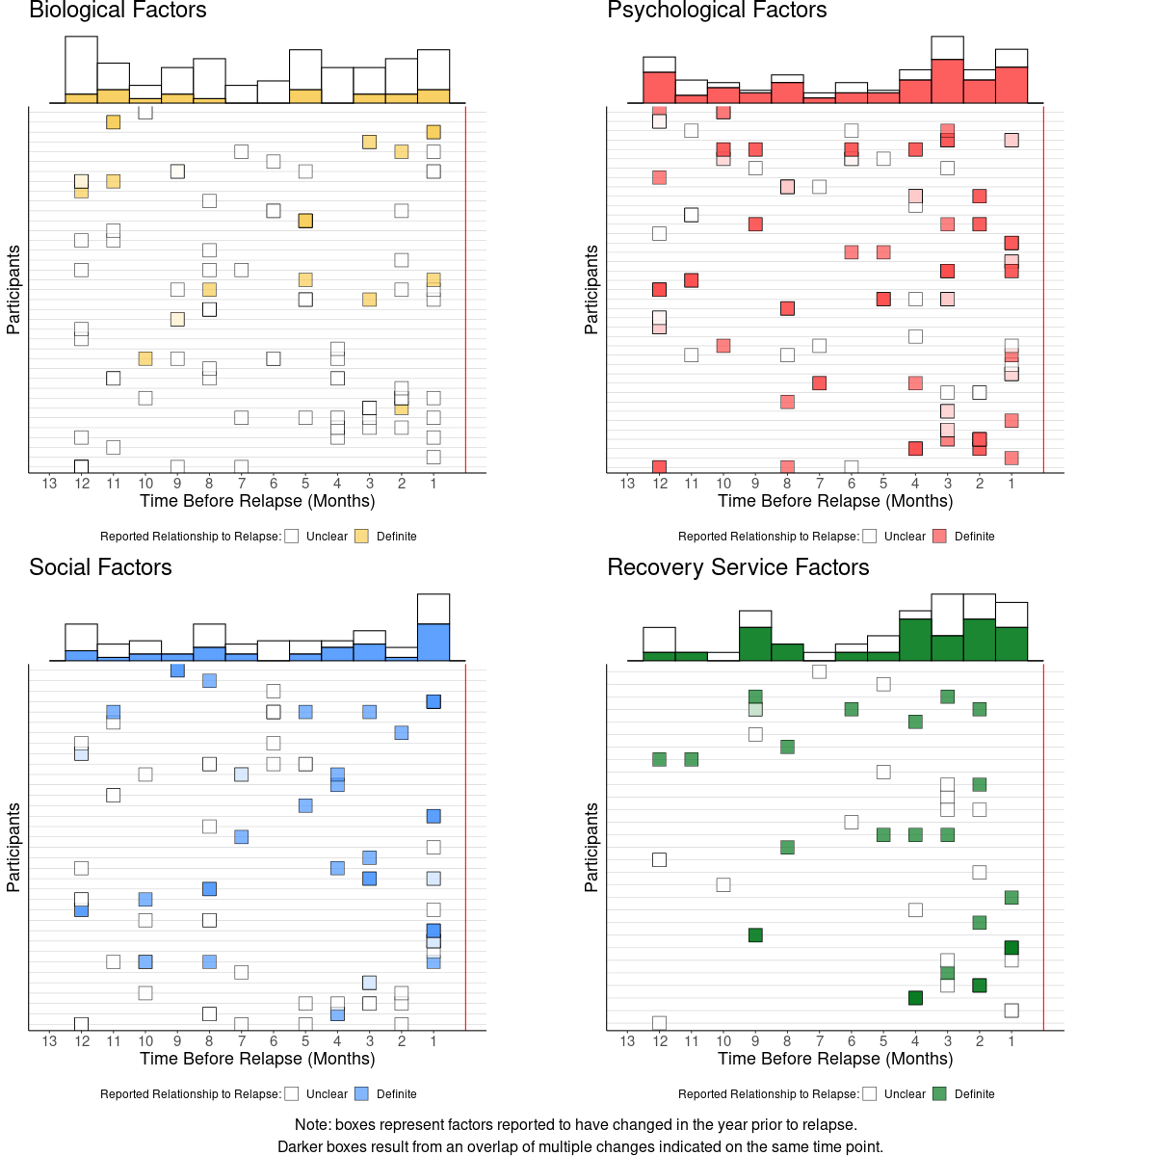
Marginal graphs show change in frequency of reported change factors across 12 months prior to relapse horizon - darker colors represent proportion that “definitely contributed” across the entire sample

Slide 78
Results: Research Questions
1. What are the commonly reported bio-psycho-social and health service use changes that occur in the year prior to a relapse following full sustained remission for individuals recovering from AUD and to what degree of certainty do such individuals attribute such changes as contributing to their relapse.
2. What is the nature and prevalence of the reported contributing relapse factors
3. When do such potential high-risk warning signs occur during the year prior to a long-term relapse.
4. What is the single most influential reported contributor of relapse among individuals in prior full sustained remission who have subsequently relapsed.

Slide 79
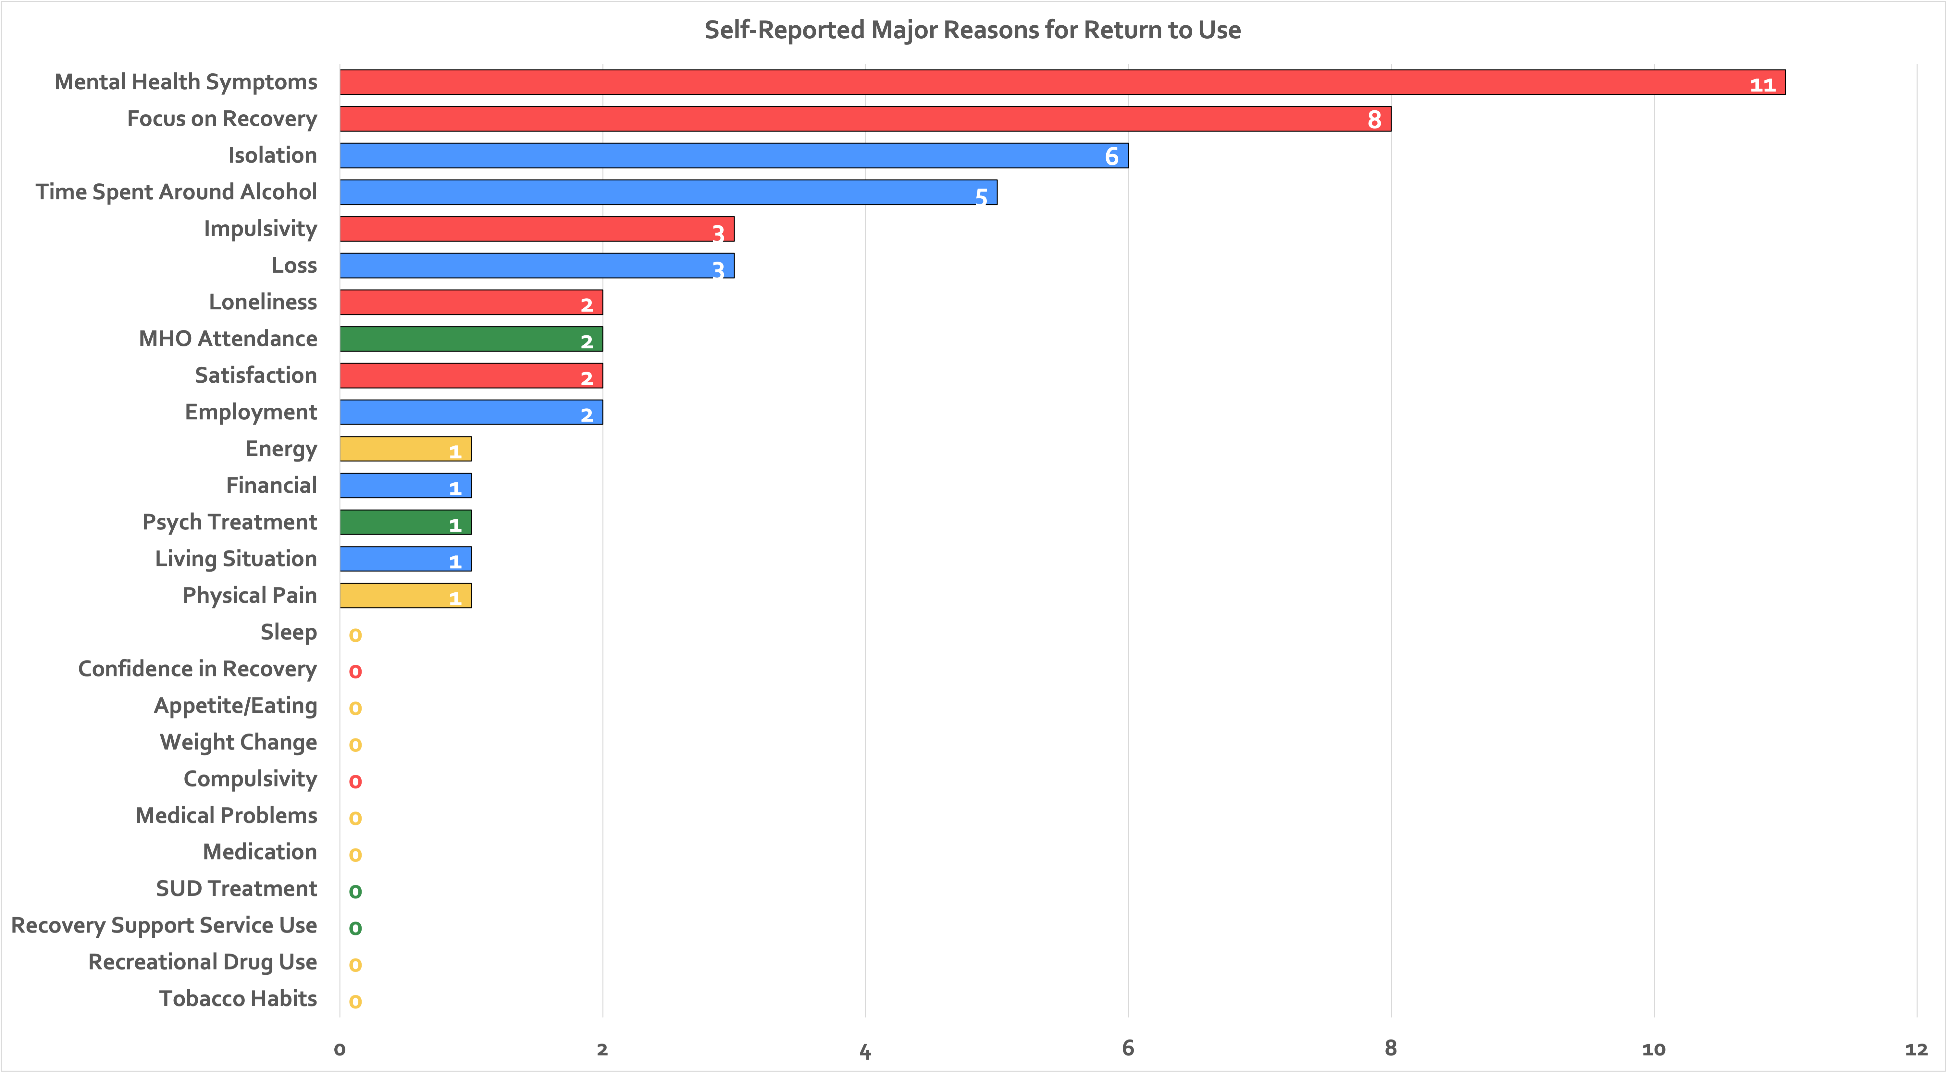
Psychological and social factors predominate in terms of single most definitely contributing factor in terms of frequency….

Slide 80
Implications
Addiction recovery journeys involve long-term accommodation and assimilation of many positive changes as well as many challenges (eustress and distress).
Lack of awareness of risk/risk potency, and avoidant coping or inadequate coping/management of bio-psycho-social and health services changes may present destabilization markers that may precipitate long-term relapse
As hypothesized, the predominance of psychological and social change factors relative to physical/biological suggest conceptual models that help explain short-term relapse risk (classical conditioning/cue reactivity inducing craving) may be better explained by stress and coping/self-regulation theories
Temporal analysis of cumulative risk across the year prior to the long-term relapse suggest a crescendo towards the relapse horizon but some factors that “definitely” contributed to relapse begin as far as 12 months prior and across the year…

Slide 81
Clinical Implications for Long-Term Disease Management
Checklist for patients to complete prior to ongoing visits involved in long-term disease management
In addition to the great need for more research into this important clinical and public health area, the array of psychological, social, recovery health services, and biological factor changes that occurred in the year preceding long-term AUD relapse detected in this study, highlight several markers and potential mechanisms that could be incorporated into a checklist for patients to complete prior to ongoing visits involved in long-term disease management.
Checklist may serve as stimulus and foundation for broader clinical discussion…
Such a list as those factors reported in this study the presence of one or more of which, could alert a clinician to focused discussion and intervention; or otherwise, serve as a stimulus and foundation for broader clinical discussion about the need for continued AUD recovery focus and successfully facing and addressing recovery and life course challenges that ultimately may help prevent further morbidity and mortality that can arise from AUD recurrence

Slide 82
Such a clinical checklist might be deployed in long-term disease management (e.g., in recovery management check-ups)…
Kelly et al (2026) Frontiers in Public Health

Slide 83
What if Really Treated Addiction Like a Chronic Disease… The Recovery Management Check-Up Paradigm
Some of the common goals of these models include:
proactively tracking patients and providing regular “checkups”
screening patients for early evidence of problems
motivating people to maintain or make changes including the return to more aggressive treatment when necessary
negotiating access to additional formal care and potential barriers to it
emphasizing early formal reintervention when problems do arise.
Core assumption of these approaches is that earlier detection and re-intervention will improve long-term outcomes…

Slide 84
Clinical Monitoring: 4-year outcomes using Recovery Management Checkups (RMCs)
N=446 adults with SUD, mean age = 38, 54% male, 85% African-American
Randomly assigned to either
Quarterly assessment only
Quarterly assessment plus RMC
RMCs
Linkage manager who used MI to review participant’s substance use, discuss treatment barrier/solutions, schedule an appointment for treatment re-entry, and accompany participant through intake
If no substance use in previous quarter, linkage manager reviewed how abstinence has changed their lives and methods used to maintain abstinence
Source: Dennis & Scott (2012). Drug and Alcohol Dependence, 121, 10-17

Slide 85
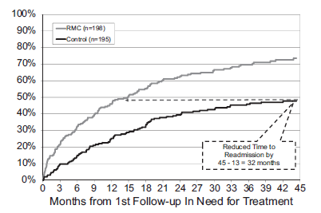
Results 1 Return to treatment
RMC participants needing treatment were sig. more likely to return to treatment sooner
Source: Dennis & Scott (2012). Drug and Alcohol Dependence, 121, 10-17

Slide 86
Results 3 Use and problems outcomes benefits for RMC participants
*All differences were significant at p<.001

Slide 87
Connecting the Dots
Toward a Recovery-Oriented System of Care (ROSC)
A ROSC is a coordinated network of treatment and community-based services and supports that is person-centered and builds on the strengths and resiliencies of individuals, families, and communities to help achieve remission and improved health, wellness, and quality of life for those with or at risk of alcohol and drug problems

Slide 88


Recovery Milestones
Initial 0-3m
Early 4-12m
Sustained 1-5yrs
Stable 5+yrs
What do we know about recovery milestones and trajectories?

Slide 89
Relevant to inform answers to Questions regarding Treatment and Recovery Support Services…
Who needs what type of service?
When in their recovery?
For what duration?
At what intensity?

Slide 90

Who?

Slide 91
40-Year Temporal Horizon of Recovery Trajectories
National
Recovery Study (NRS)
N=2,002
Kelly et al, 2018; Beyond Abstinence; Alcoholism: Clinical Experimental Research

Slide 92
Changes in Recovery Capital and Quality of life Among Different Primary Substance Groups
in first 5 yrs of Recovery
Kelly et al, 2018; Beyond Abstinence; Alcoholism: Clinical Experimental Research

Slide 93
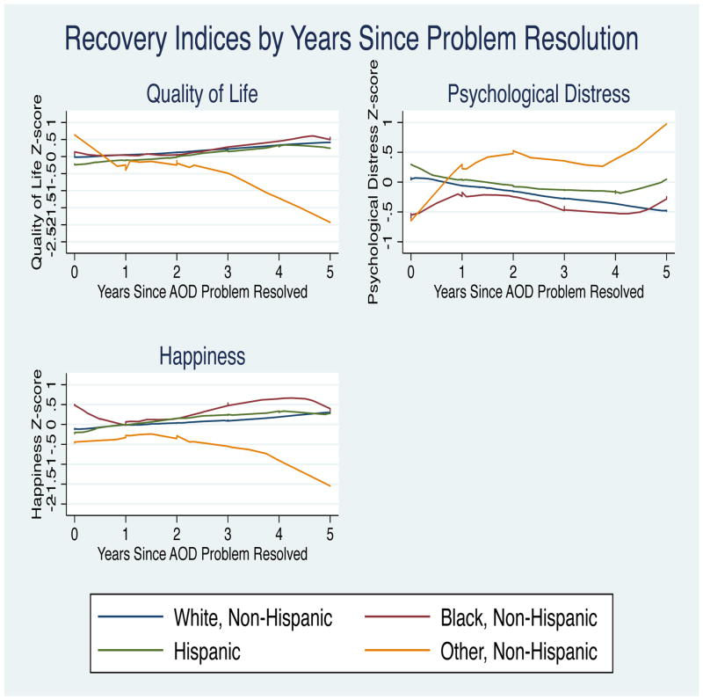
Changes in Quality of life, Distress, Happiness Among Different Racial/Ethnic Groups
in first 5 yrs of Recovery

Slide 94
Sexual Minority vs Heterosexual Status and Changes in Functional and Well-Being Indices - 40 yr. temporal horizon
Haik et al 2022

Slide 95
Kelly and Eddie, 2019, Psychology of Addictive Behaviors

Slide 97
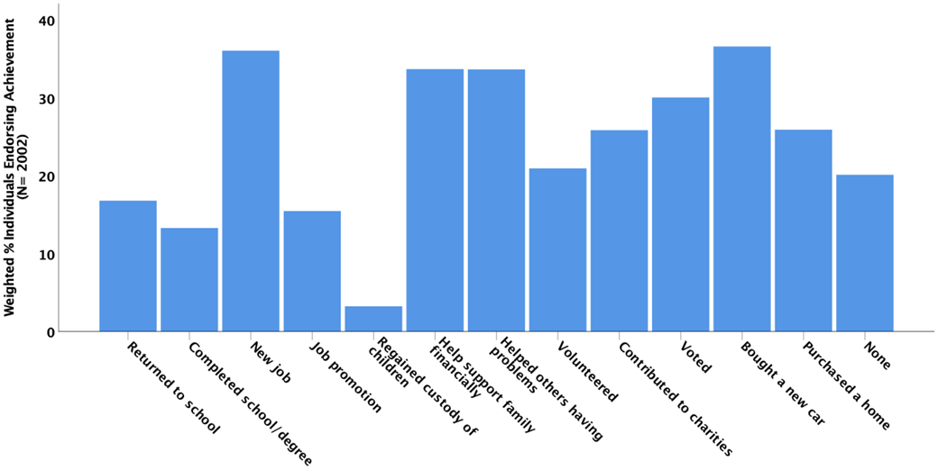
Reasons to Be Cheerful: Prevalence in the United States population of achievements since resolving a problem with alcohol or other drugs (AOD)

Slide 98
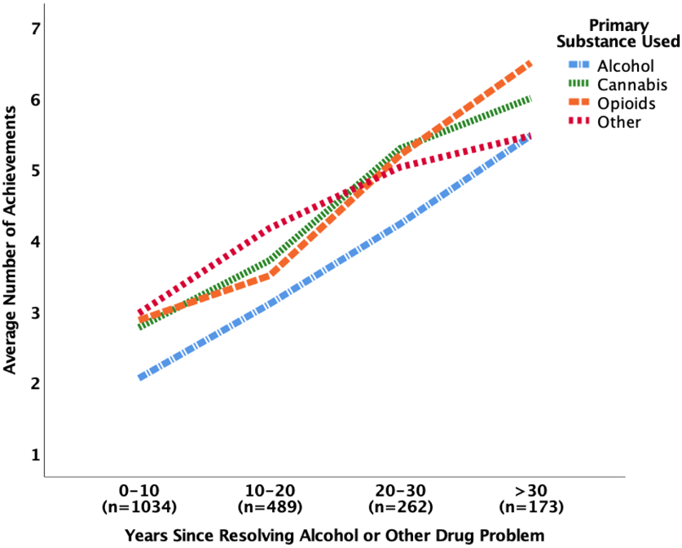
Average number of achievements accomplished by 10yr time periods since AOD problem resolution, and primary substance used

Slide 99
When?

Slide 100
40-Year Temporal Horizon of Recovery Trajectories
Inflection point at around 5 yrs
Kelly et al, 2018; Beyond Abstinence; Alcoholism: Clinical Experimental Research

Slide 101
2-yr Year Temporal Horizon of Recovery Trajectories
Kelly et al, 2018; Beyond Abstinence; Alcoholism: Clinical Experimental Research

Slide 102

Recovery Curve Preliminary Data-Based Recovery Milestones and Tasks…
Conservation &
Growth
(corrective, preventative, risk-based, maintenance)
Reconstruction
(building materials,
building permits)
Industrial
Resolution
Assessment and
Appraisal (paradoxical distress)
Dawning of Reality
(Smoke clears; “alarm”)
Improved Functioning Quality of Life Well-Being
Convalescence
(Fire is out; “calm”)
Initial (0-3m)
Early (4-12m)
Sustained (1yr-5yr)
Stable (5+yrs)
Recovery Duration
Based on Kelly et al, 2018; Beyond Abstinence; Alcoholism: Clinical Experimental Research

Slide 103
Some lingering challenges and final thoughts…

Slide 104

Some lingering challenges and final thoughts…
Reaching people who can benefit from services…
About 90% of individuals with SUD do not seek specialty care
How can we reach these individuals/reach them sooner?
The majority of people who do, take many years to achieve stable remission and resilient recovery
How can we help individuals to get access to the scaffolding, building materials, and building permits to shorten the time to recovery/stable recovery?
Technological innovation may, in part, facilitate greater access, utilization, and benefit, at least for some…
Severe
(~21%) ≈ 10M
(High morbidity / mortality)
Moderate
(~23%) ≈ 10–11M (Missing Middle)
Mild (~56%) ≈ 26–27M

Slide 105

But, in a high-tech world, at its core, recovery remains low-tech

Slide 106

Fast Car – Tracy Chapman
“… and your arm felt nice wrapped around my shoulder, and I felt like I belonged, and I felt like I could be someone…”
Notes:
The sense of belonging and becoming… we need to feel like we belong and fit in; and that we can find our feet and be someone (meaning and purpose). Oftentimes, early in recovery the belief of becoming who you were meant to be comes initially from others who show faith and belief in that individual. Gradually, that person themselves starts to believe that themselves … going from invisible to visible to counting and to being counted.

Slide 107









John F. Kelly, Ph.D., ABPP
@johnkellymgh
Recovery Research
@RecoveryAnswers
Recoveryanswers.org
@YouthRecoveryAnswers
@YouthCenterRRI
recoveryanswers.org
Thank you!
Contact information:
John F. Kelly, Ph.D., ABPP
Jkelly11@mgh.harvard.edu
Recovery Research Institute
National Center on Youth Prevention, Treatment, and Recovery
Massachusetts General Hospital
151 Merrimac St., Floor 4
Boston, MA 02114

